Slide 1
Aspect Extraction using Pattern Dependency Rule Based
Mochamad Rakha Luthfi F – 1301164573
Joshua Panjaitan - 1301164044

Slide 2
Aspect Extraction
Cleaning Data
Mendapatkan pola keterhubungan antar kata
Membangun rule based AE.
Memisahkan fitur dan opini
Testing

Slide 3
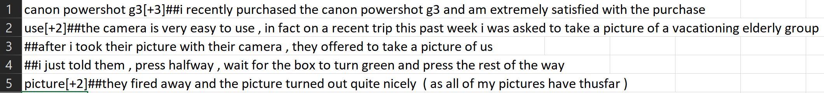
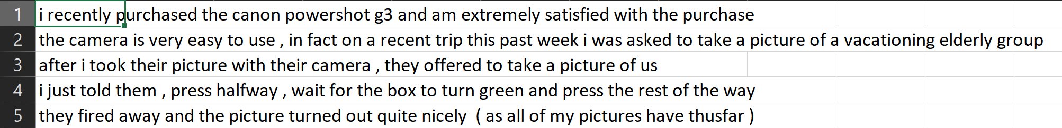
Cleaning Data

Slide 4
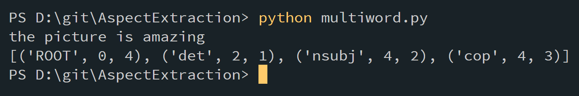
Mendapatkan pola keterhubungan antar Kata
Menggunakan Stanford Dependency Parser

Slide 5
Membangun Rule Based AE.
Sumber : Bancken,Alfarone,Davis. (2014). Automatically Detecting and Rating Product Aspect from Textual Costumer Review. Department of Computer Science, KU Leuven Celestijnenlaan 200A

Slide 6
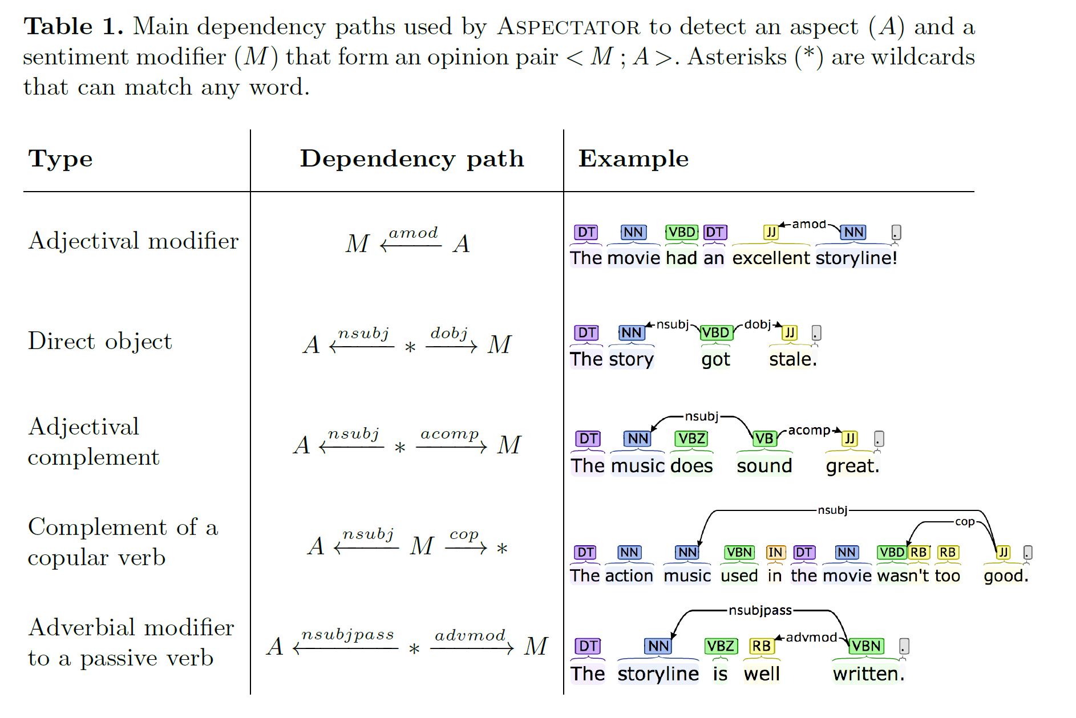
Membangun Rule Based AE.

Slide 7
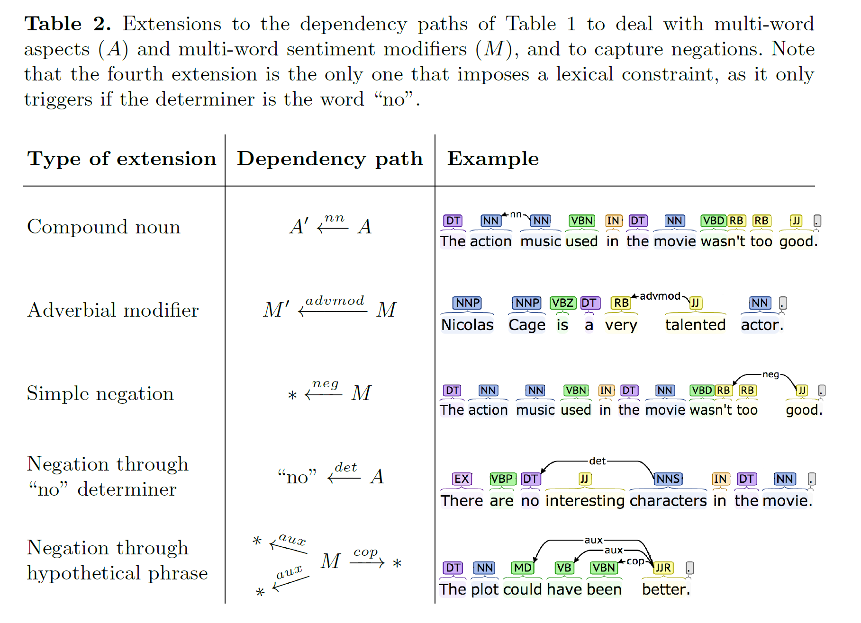
Membangun Rule Based AE.

Slide 8
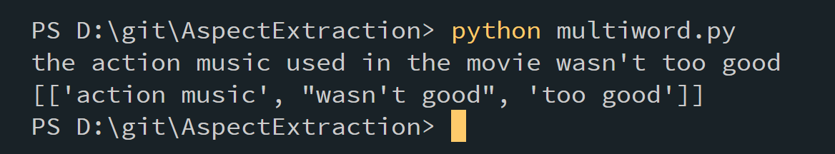
Memisahkan Fitur & Opini

Slide 9
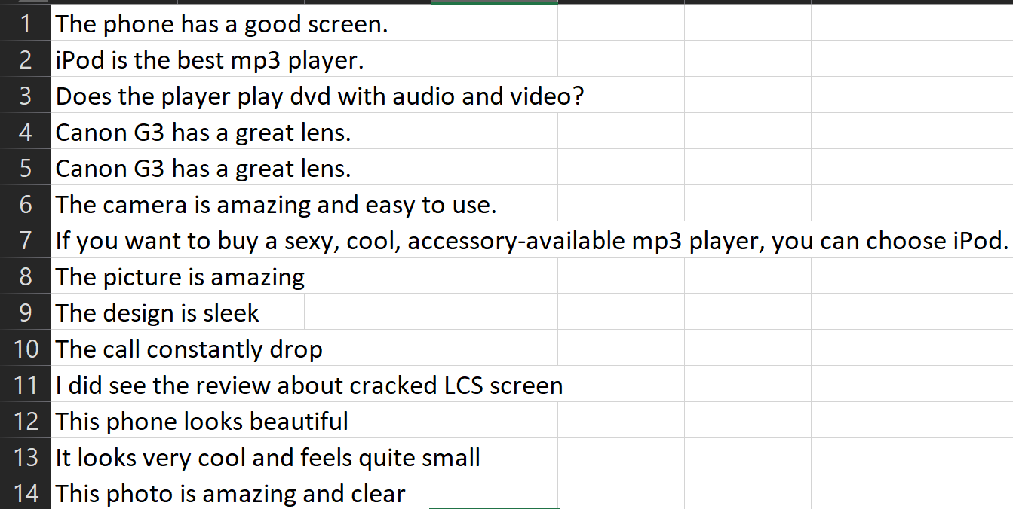
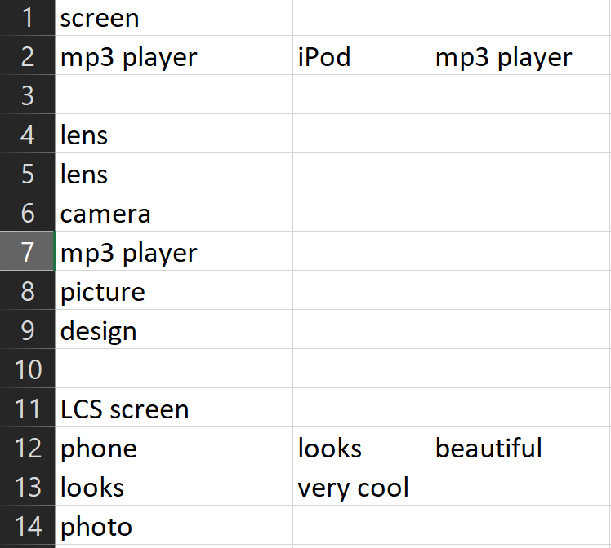
Testing

Slide 10
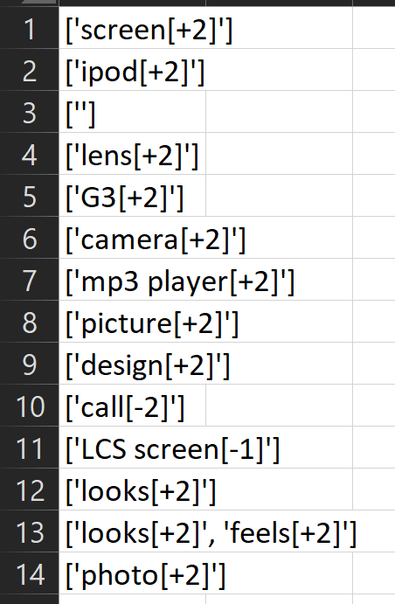
Akurasi
78 % of Recall
64 % of Precision

